Slide 1
What’s next? Findings from our vision canvas workshop Wednesday 18 October 2017
@dug

Slide 2
What’s in this presentation 1) How we got here and where we are going 2) Summary of findings from our workshops 3) Updated design principles and themes 4) Initiatives (what we plan to work on next)

Slide 3
What we’ve done so far… (and what’s next in the plan)

Slide 4
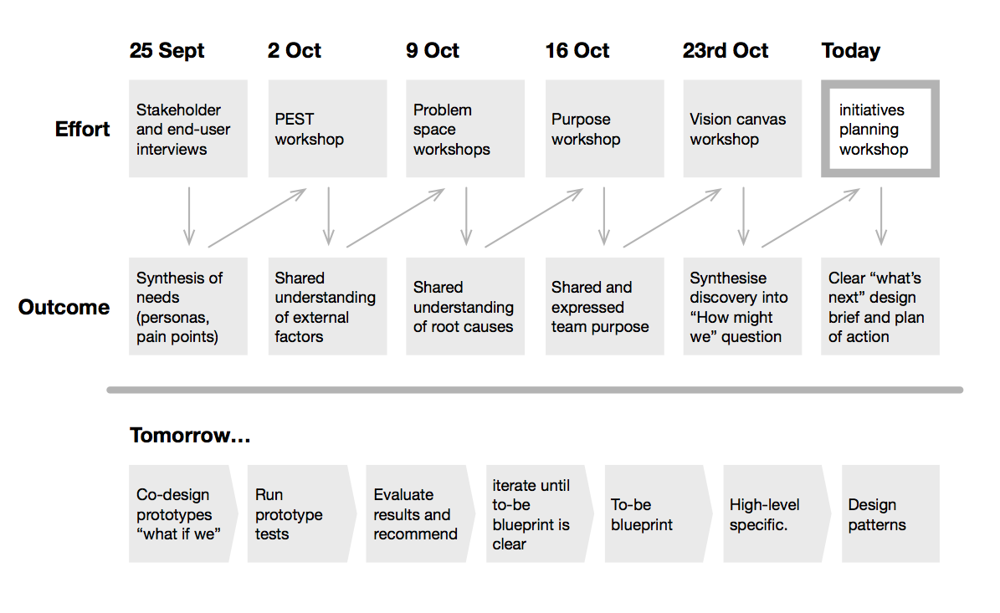

Slide 5
…and why, how does the process build towards results?

Slide 6
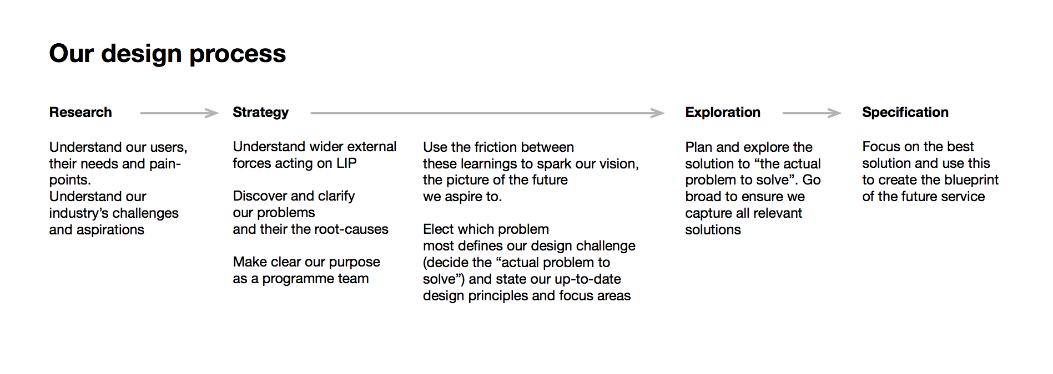

Slide 7
Summary of research and workshop findings

Slide 8
Environment In our canvas workshop we discussed the findings of our PEST analysis. Certain parts of the analysis stood out as important in defining our vision

Slide 9
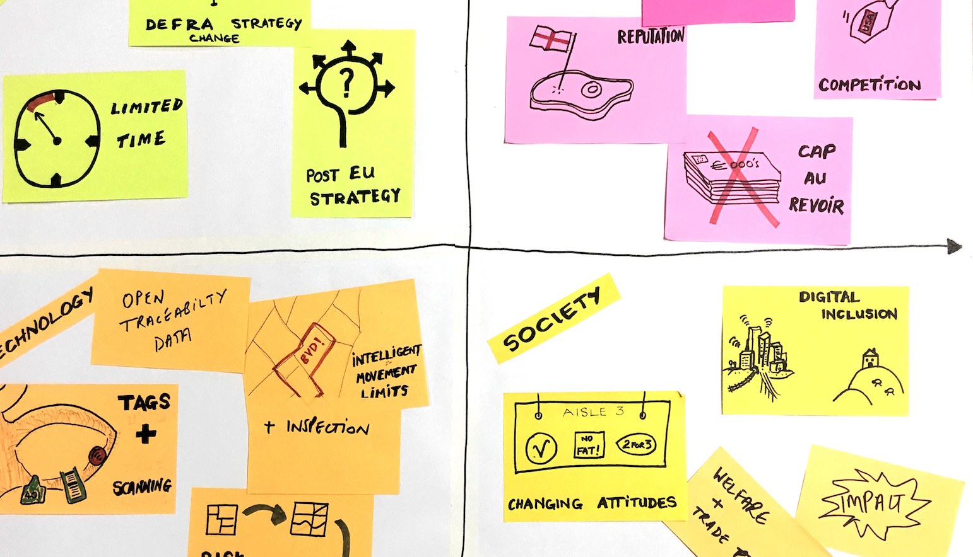
PEST: Of the environmental factors identified in our PEST analysis of the space LIP is operating in, the biggest question mark surrounds the end of of CAP. Depending on the outcome, the very nature of our rural economy and society might be on track for a painful transformation by 2024 unless we get the post-EU transition right.

Slide 10
Problems We reviewed our problem space. This was an attempt to uncover both root causes and identify what problem areas were most in need of addressing

Slide 11
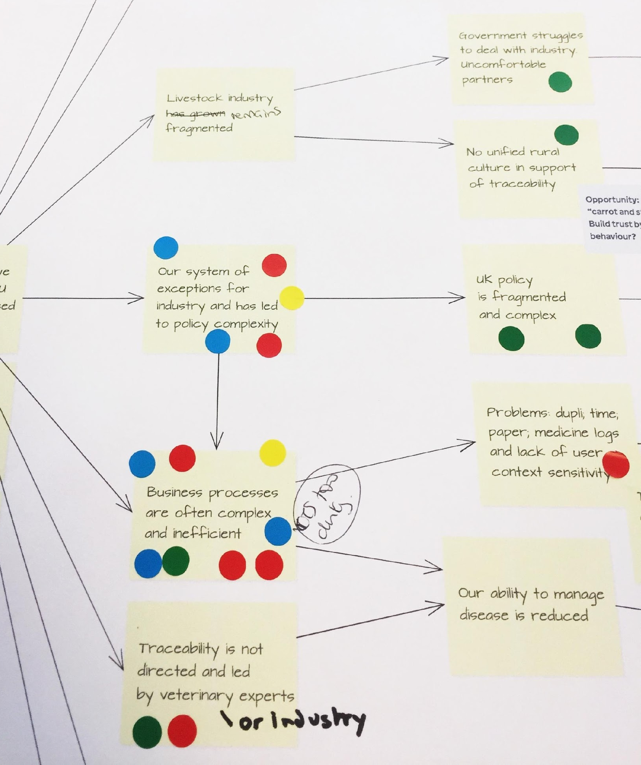
We believe the "actual problem to be solved” is that: As a result of the way we have been shaped by EU incentives and penalties, there is currently no reliable flow of traceability data between government and our livestock industry. This “virtuous cycle” of data, is a prerequisite to improving both livestock quality and disease management.

Slide 12
Purpose In earlier sessions, team members had gathered to try and express our “transcendent purpose” using a service design tool. The outputs of that tool were voted on in the canvas workshop

Slide 13
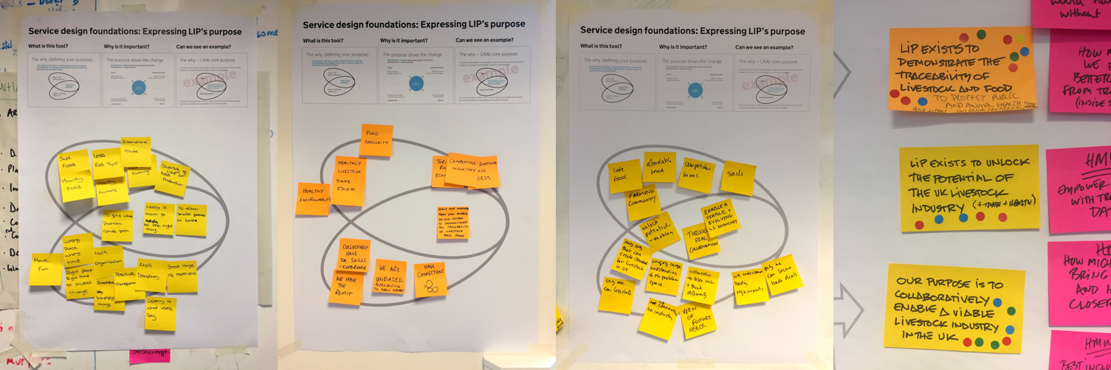
We must select a single purpose that defines our programme. This transcendent purpose is: We exist to use traceability to unlock the potential of a sustainable, viable livestock industry in the UK
* Workshop participants will note that other issues were debated that do not appear in this result. In order to progress our design briefing and to design early prototypes for testing, trade and disease management are captured in our “design principles” section. Strategic initiatives and design principles go hand-in-hand, so your concerns are very much still with the team.

Slide 14
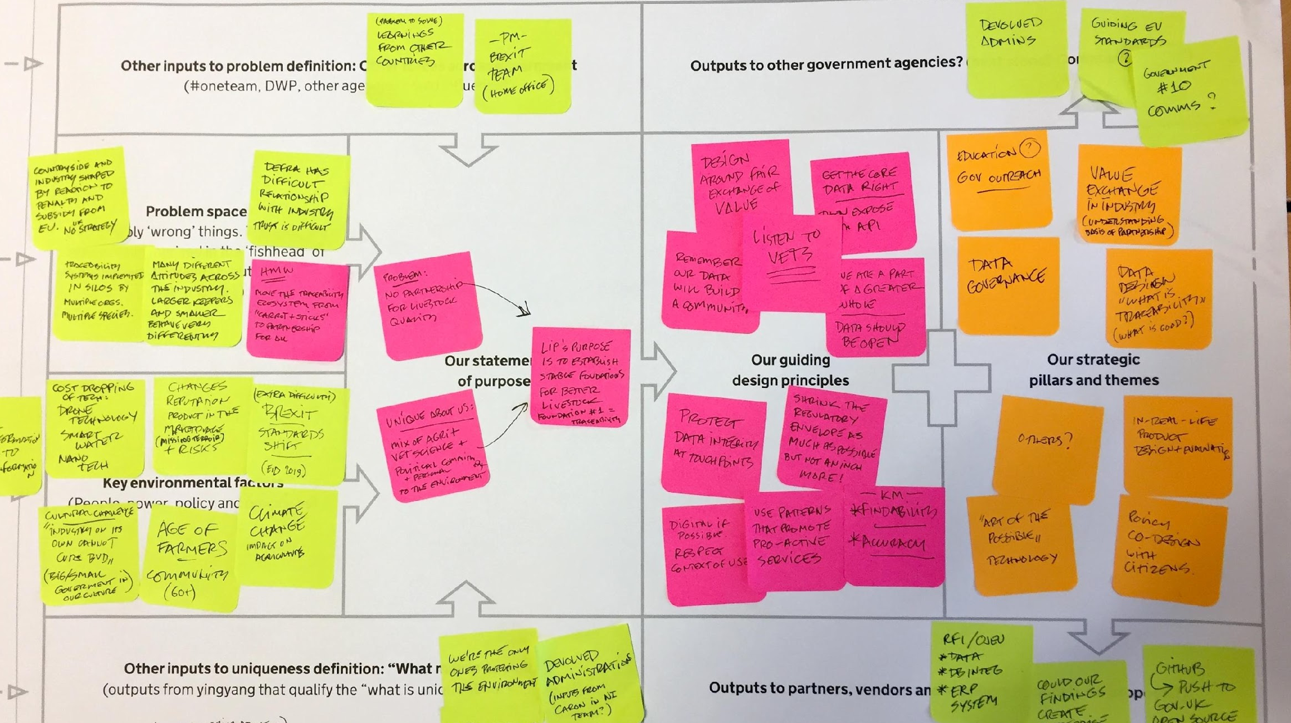
We then completed a canvas to bring our environment + our problems + our purpose into one place to express our vision:
@dug

Slide 15
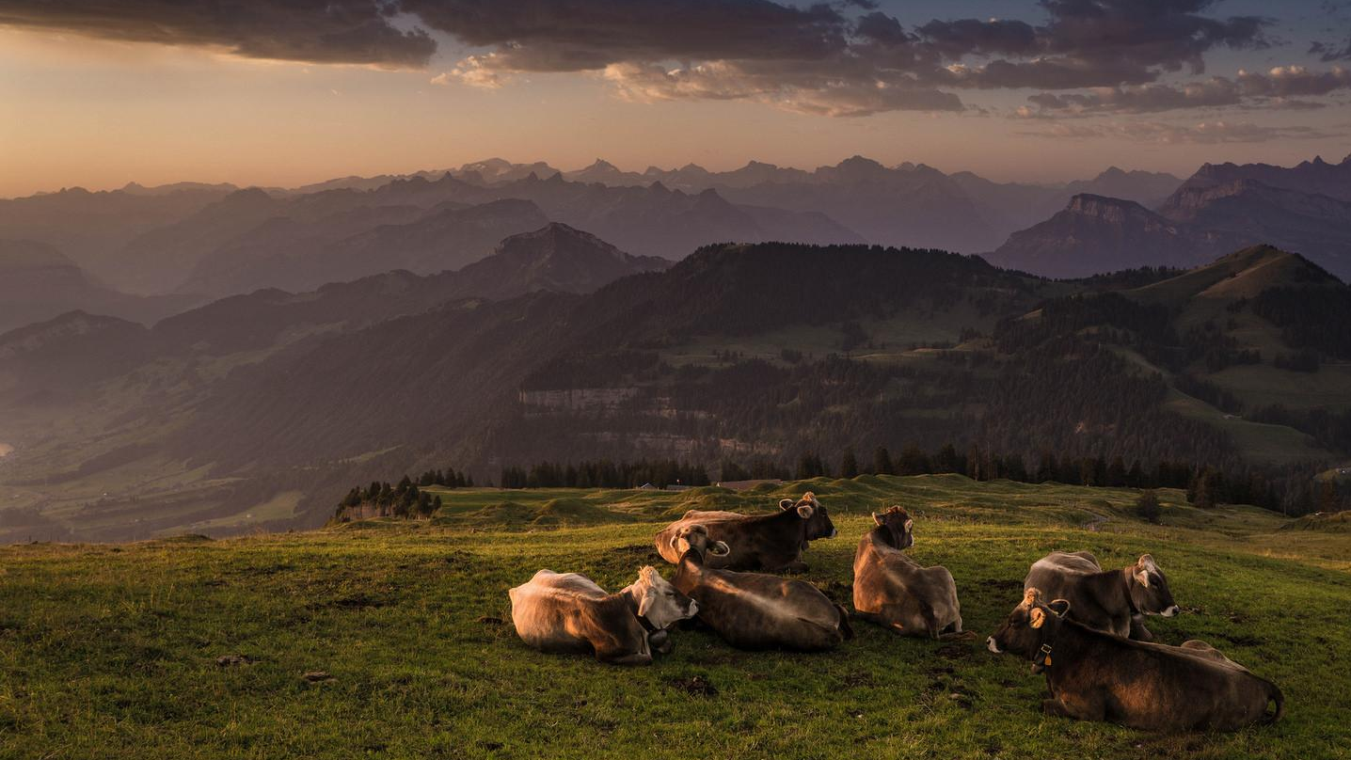
Programme vision
We have a shared vision that over the next five years we will support building a world where our livestock industry is doing the right things for all the right reasons.
In this new world we will see healthier livestock farming and a stronger partnership between government and industry based on shared responsibility and collaborative risk management.
We believe this cannot be done by waiting for external factors to be resolved. Instead, we will lead the creation of our own future.

Slide 16
LIP Design principles (these guide our design)

Slide 17
In what way should we get to where we're going? How do we know if we're doing things the right way?

Slide 18
1) We leverage the “Power of Three” Improved animal disease management, better foreign trade and a stronger, and happier livestock industry are all completely interlocked in our future. As we design our new LIP service, we will never focus on one without considering the other two. These three pillars must be considered, enabled or improved by every initiative we take.

Slide 19
2) The Crown leaves no one behind As we forge ahead with the exciting improvements and creative solutions to the challenges we have identified, we will never forget to factor in the smaller, the disadvantaged, those who lead a more precarious experience in our country. LIP is for all.

Slide 20
3) We will build partnership The only way we will reach our future objective is to build a strong partnership between industry and government. This partnership will require cultural change but will enable the growth of best practice for all participants. We will always keep this partnership front-of-mind as we design the new service

Slide 21
4) We will build the right knowledge, the right way for the right reasons Our aspiration is to enable lifetime traceability of livestock. Where possible or appropriate this will also mean tracing individual animals. As we plan ways to achieve this we will always evaluate the true value of knowledge in the wider service context to ensure we only invest in data that will provide genuine returns.

Slide 22
5) We will embrace the opportunity of digital and data Digital is not an end in itself. Creating better services that help our customers reach their objectives is the target. As we design our new service, we will always make the most of digital and data to maximise the usefulness, simplicity, scalability, and accountability our our new service

Slide 23
6) We will enable the flow of information Aside from being as open as possible, everything about our new service will build towards a solution to our primary problem, the current lack of good flow of traceability information between industry and government.

Slide 24
7) We will be accurate and be seen to be accurate As agents of the crown, we are responsible for the quality of our data and the impact that data has on our society. Every service design element we introduce must support the creation of a very accurate and transparent data-driven service

Slide 25
8) Shrink the regulatory envelope as much as possible but not an inch more! As part of our new design, we will encourage lightweight legislation. We will always work with policy-makers as one unit to ensure we reduce the weight of control on industry as much as possible within the correct quality and accountability envelope.

Slide 26
On the way we are working. Our approach is about:
Working in the open, through a single multi-disciplinary team
Designing services end to end and back to front – prevents siloed solutions to problems (e.g. just through a policy or business lens)
Uses a lot of visual and design tools to bring to life problems and solutions, so people can really engage with them
Uses prototypes as a means of testing thinking ideas rather than consulting over them
Works well in a two-week sprint cycle – showing incremental progress in creating the design
Many other things:-)

Slide 27
Strategic pillars and themes (broad areas we believe we need to keep focussed on)

Slide 28
Best possible data design to encourage transparency and accountability
Policy co-design and build everything on the basis of fair and transparent value exchange
Building bridges and co-creating the change with the power of three
Fully understand the digital and off-line ecosystem to ensure seizing the digital opportunity has the right outcome for all

Slide 29
The strategic initiatives (what we plan to work on next) This is the work we need to do to find potential answers to our “how might we” questions. Further detailed explanation in separate document

Slide 30
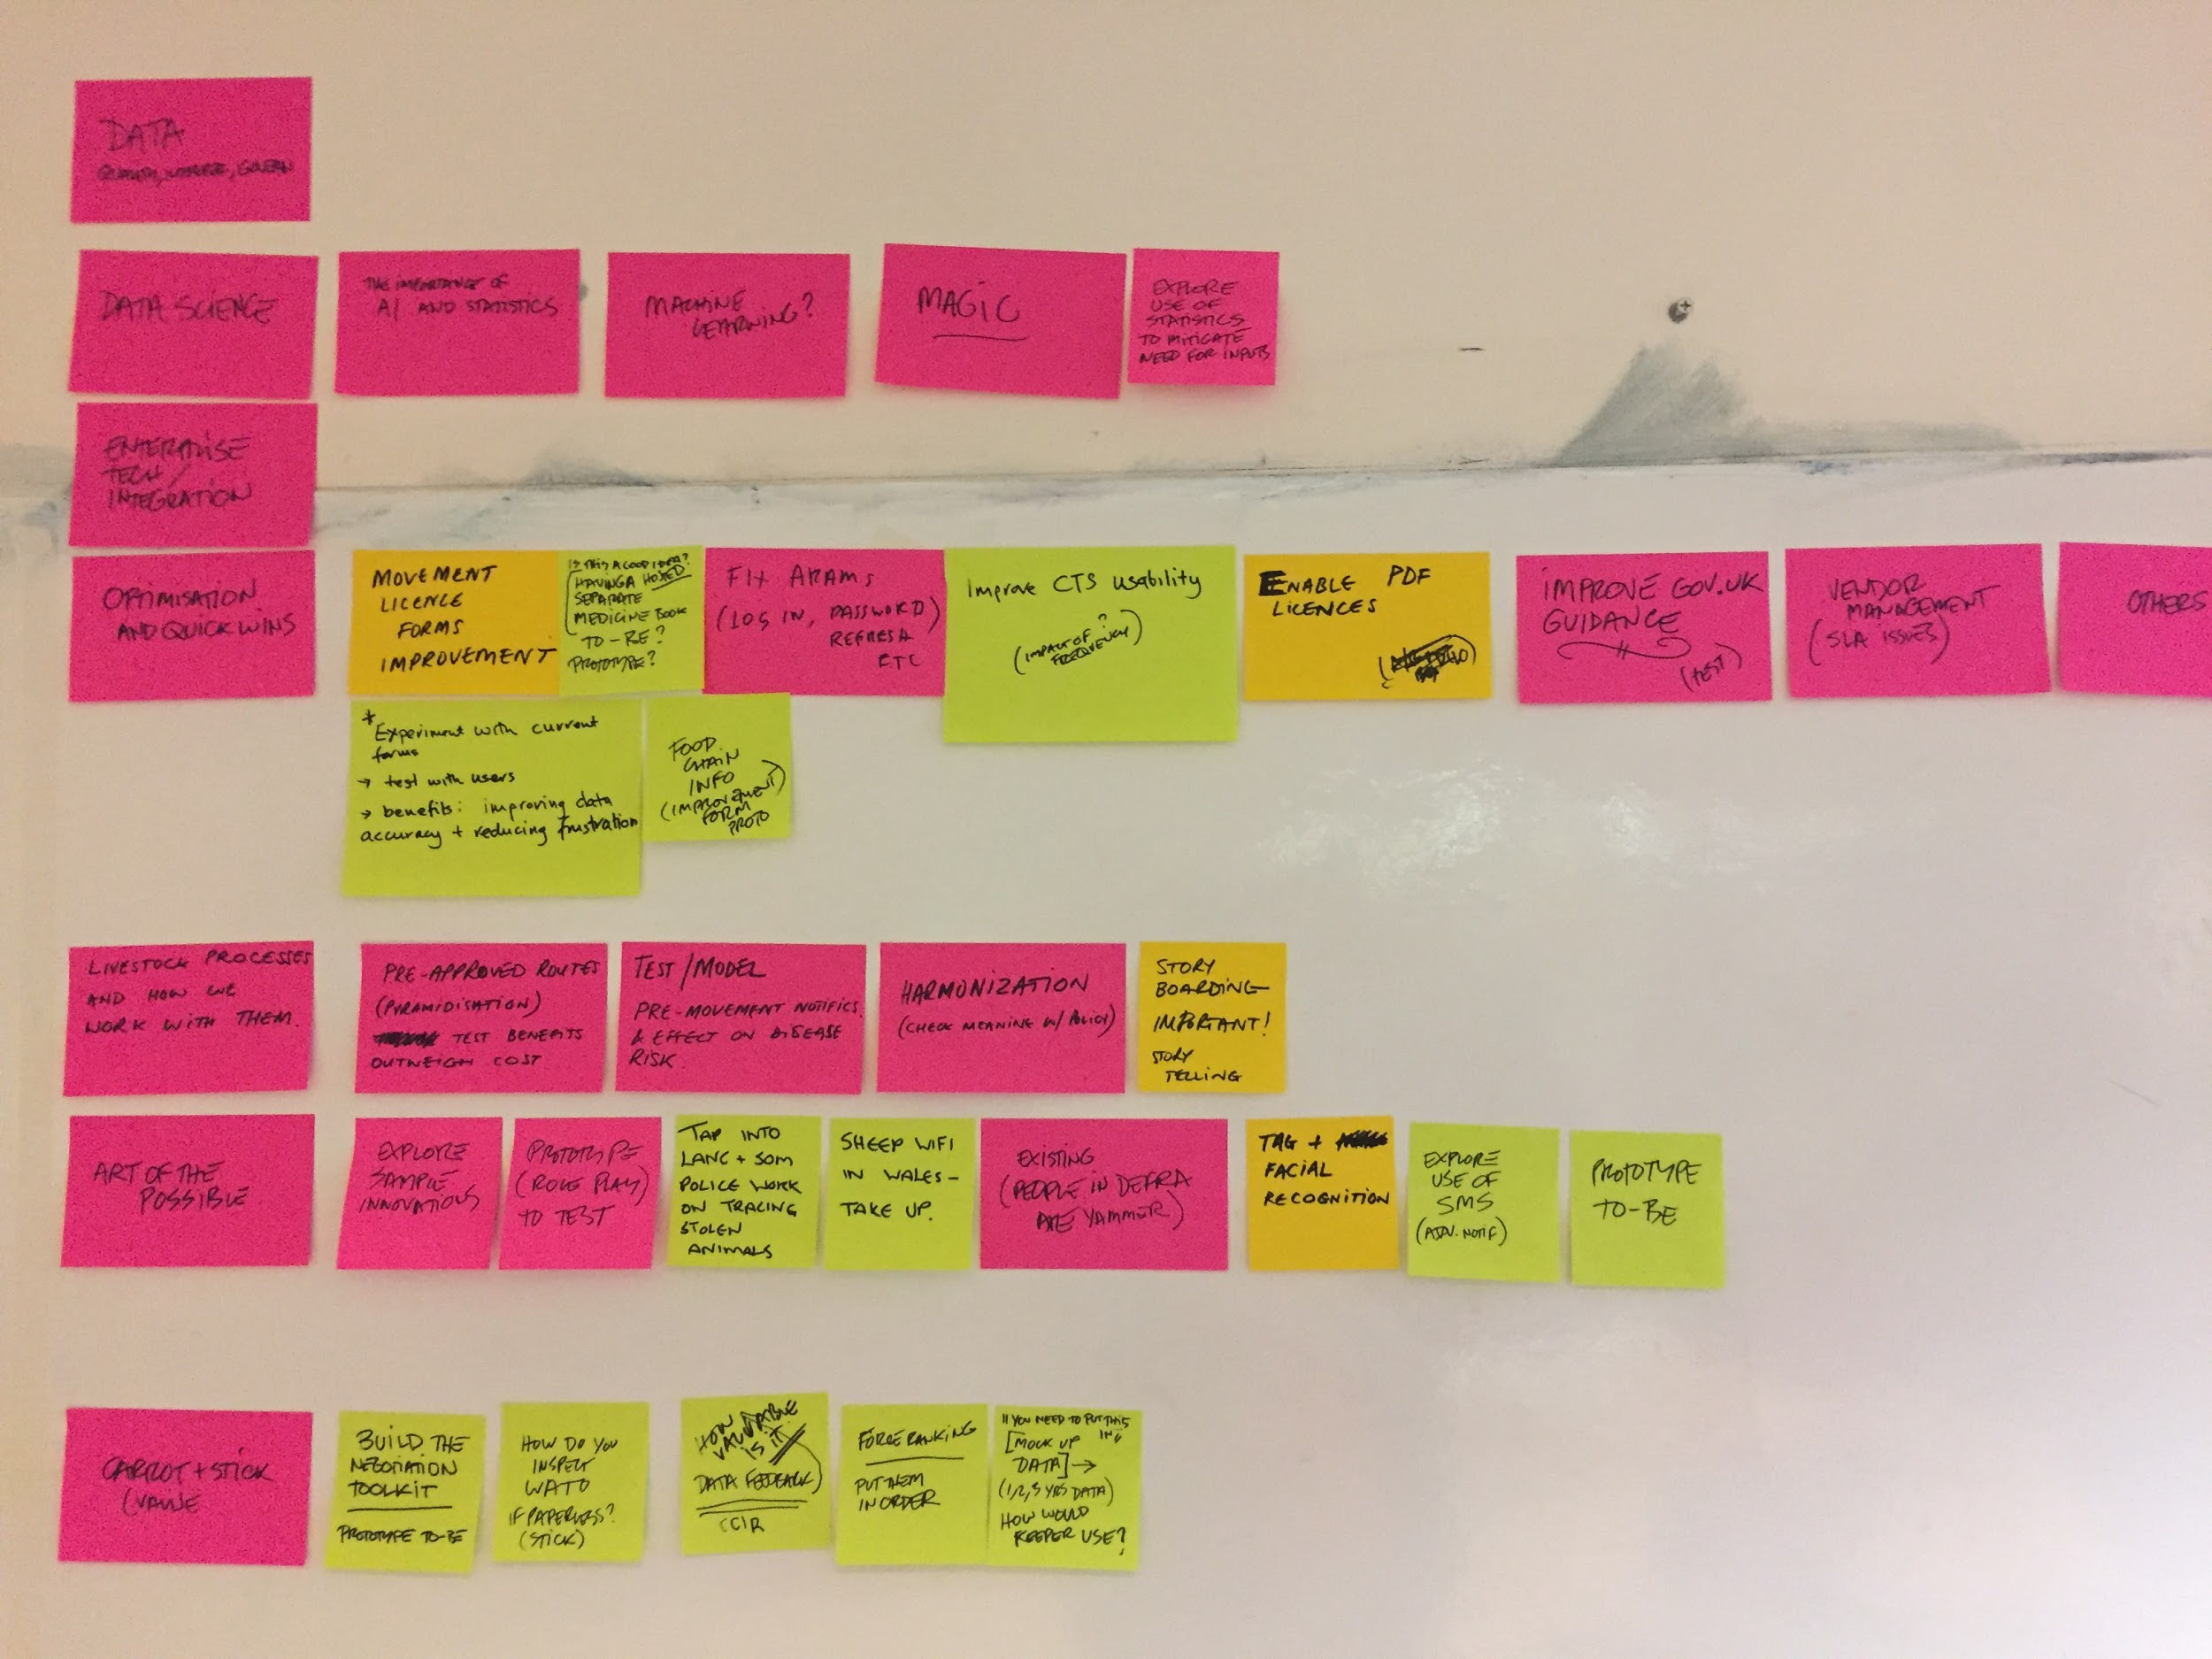
First draft
Machine learning, AI and big data jump starts | Things that give us better data / quick start opportunities | Optimisation and quick wins | How we work with farming systems themselves | Art of the possible
Risk in the system | Leaving no-one behind | Ways to enable a multi-quality industry | Ways to present a single world-facing view | Going beyond carrot & stick
Additional non-service-design-led initiatives / work-streams: Data; Enterprise architecture and systems
integration; Org Design (manage organizational change). Also important and in progress: Accelerating
service and policy design plan coordination.

Slide 31
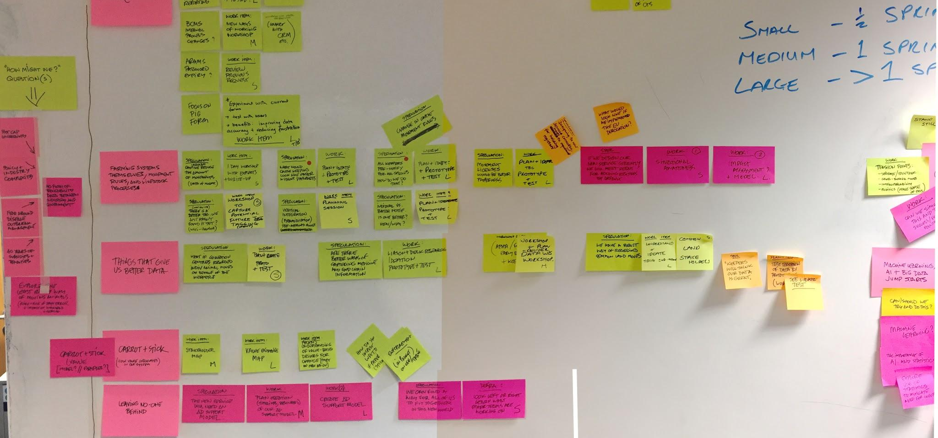
Second draft (prioritisation)

Slide 32
Initiatives mapped to plan
As of Fri 3 Nov our plan of action for the next phase is 50% complete. As soon as the mapping is completed, the team will share this information which includes answers to questions such as “what are we focussing on first.”

Slide 33
Thanks
@dug

